Slide 1
Integrated Ball Nut Bearing Assembly- Manufacture Internally
July 17, 2015

Slide 2
GSM Strategy
CW Bearing is currently a strategic supplier of the Ball Nut Assembly to develop and grow the business within GSM
CW Bearing is breaking ground in Northville, MI to support T1XX program specifically for the integrated ball nut bearing
GSM is in discussions to establish a footprint within Mexico to assist in assembly and development of new programs for the integrated ball nut.
Please note that we have agreed upon Terms and Conditions which cover Warranty, Recall, Liability, Service, and Indemnification

Slide 3
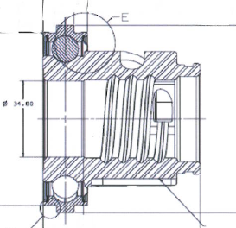
Request to Outside Suppliers
Request was sent to Ina Schaeffler and Koyo Bearing to investigate an interest in developing an Integrated Ball Nut Assembly with Nexteer.
Quote any design and development costs (i.e consultant)
Understand capital investment
Request was to design and develop parts for:
Outer Race
Cage
Balls
Grease

Slide 4
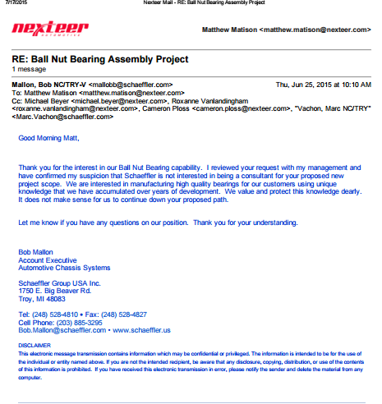
Integrated Ball Nut Bearing Assembly Response from INA Schaeffler

Slide 5
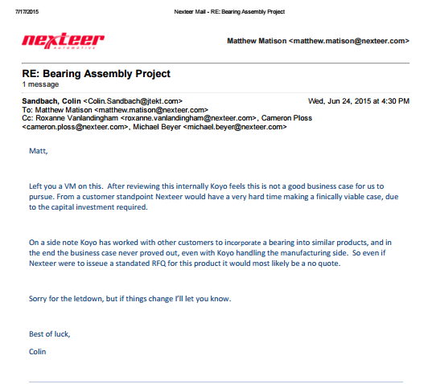
Integrated Ball Nut Bearing Assembly Response from Koyo

Slide 6
Overall Response
Bearing Suppliers objectives are to design, manufacture, and assemble in house.
They specialize in the design and development of these components and normally provide a warranty based on the dynamic loads of the system.
For example they will not provide a warranty or guarantee for the balls if the surface they ride on is not machined internally by them

